Slide 1



IoT Security fun-damental
Cyber Sec
An Offensive Perspective
Satria Ady Pradana
April 14th, 2020

Slide 2
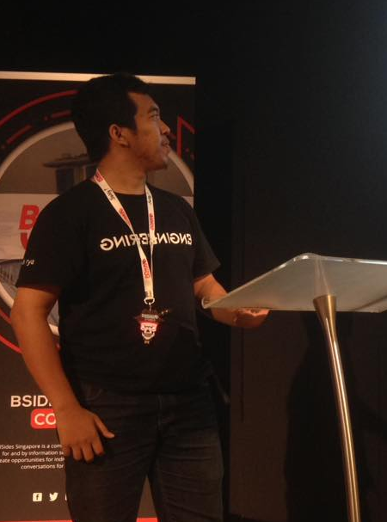



Who am I?
Satria Ady Pradana
Ordinary Cyber Security Guy
Cyber Security Consultant of Mitra Integrasi Informatika
Penetration Tester, Red Team
IoT / OT Cyber Security Special Interest Group
Community Leader of Reversing.ID
Love Low-Level Stuffs
xathrya
xathrya
@xathrya

Slide 3
Imagine in (Near) Future …
Notes:
Imagine in near future, we live in era …

Slide 4
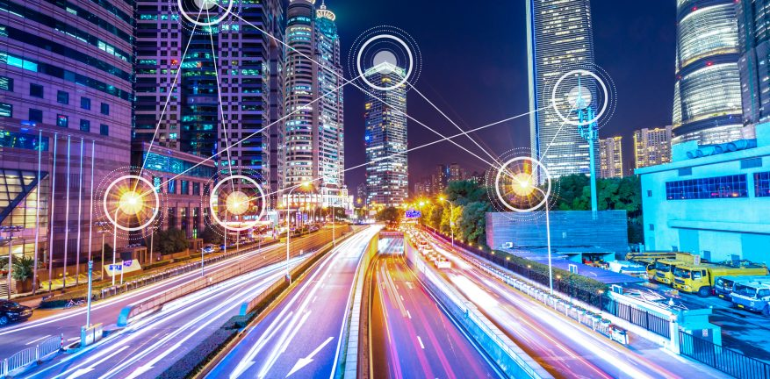
Smart City
Notes:
Smart City: city infused with technology to improve living experience
Features:
street light: public lighting adapts, dims when no activity and brighten up when detecting motion
traffic light: coordinate with cluster of traffic light to regulate the traffics.
Results:
Get information of how city is functioning in real time
Predicts how crowd react to something

Slide 5
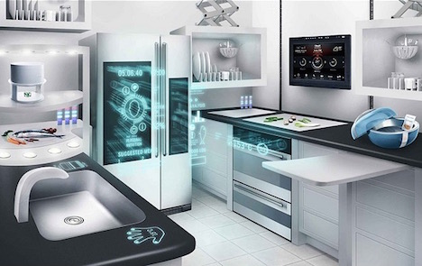
Smart Home
Notes:
Smart Home: living area with connected technology meant to enhance the home
adapts the room temperature based on people inside.
detect visitor and devise countermeasure for uninvited guests
dish suggestion based on available ingredients and reminding for restocking the supply (or even contact the vendor automatically).

Slide 6
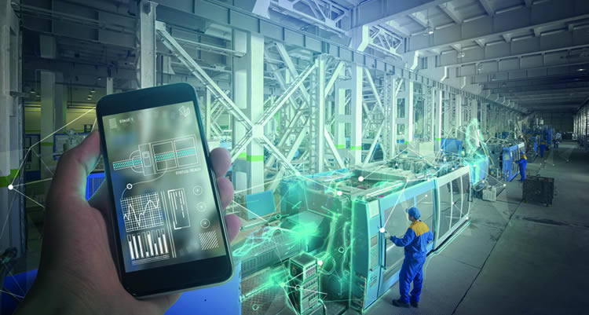
Smart Factory
Notes:
Features:
Get the current condition of machine
Detect anomaly of production machine
Coordinated goods transporting between warehouse and machine.
Results:
Predict machine wear off

Slide 7
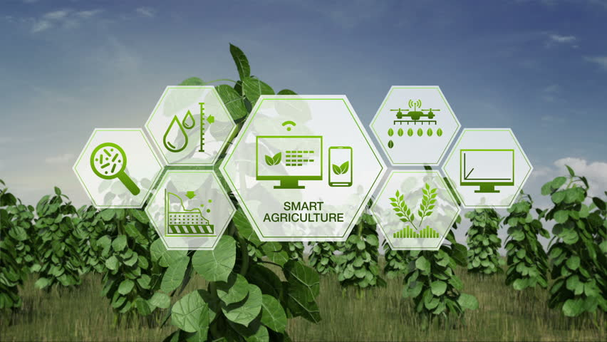
Smart Agriculture
Notes:
Features:
Automatic plant watering
Soil condition monitoring
Results:
* Efficient soil treatment

Slide 8
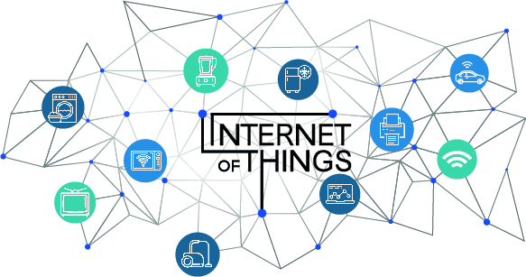
Small; Connected; Continuous

Slide 9
Danger Classification
DISASTROUS
Cause irreversible damage
DISRUPTIVE
Disrupt operational processes.
What if,
it can be intentionally triggered?
DAMAGING
Enable information stealing
Notes:
Function failure -> can happen to any system.
Failure can lead to danger.
What if the failure can be intentionally triggered?

Slide 10
Security Issues
Authentication: how to prove identities claimed by devices or users?
Authorization: what set of actions a user can do?
Update: how do we upgrade the system or part of it?
communication:
how do we ensure no one can read or modify the messages?
how do we detect and response to disruption the communication channel?
Data: how do we ensure the generated data are valid?

Slide 11

2018
Weak Guessable or Hardcoded Passwords
Insecure Network Services
Insecure Ecosystem Interfaces
Lack of Secure Update Mechanism
Insufficient Privacy Protection
Insecure Data Transfer and Storage
Lack of Device Management
Insecure Default Settings
Lack of Physical Hardening
Internet of Things

Slide 12



Security on IoT is a serious concern …
Development
Monitoring
Assessment
Notes:
Often IoT is mission critical, security should be

Slide 13
Unique Approach
Cyber Sec
Rapid growth, massive volume.
Distinctive technology.
Wide range of implementations.
Multilayered stacks.
End to end system.
Web protocol technology.
Embedded systems
Knowledge Needed
Notes:
IoT pentest need unique approach
It also need specific knowledge that might be specialized field

Slide 14
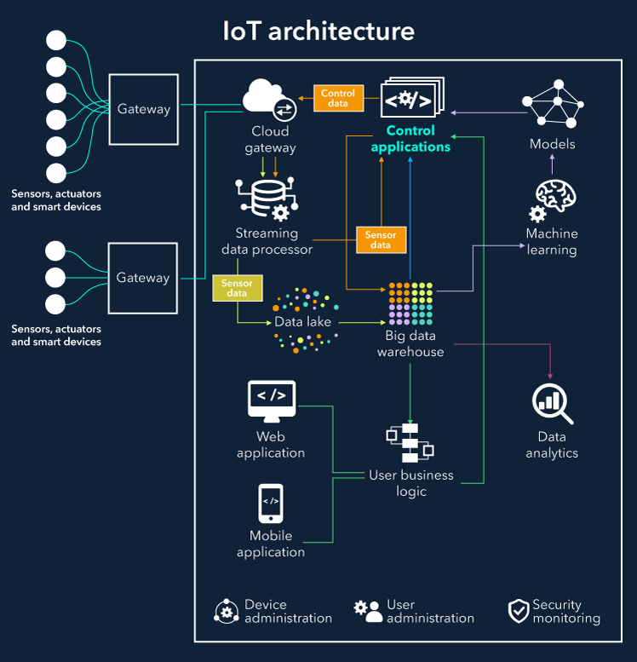
Nodes
Edge Gateway
Cloud Gateway
Data storage
Analytics
User business
Cyber Sec

Slide 15

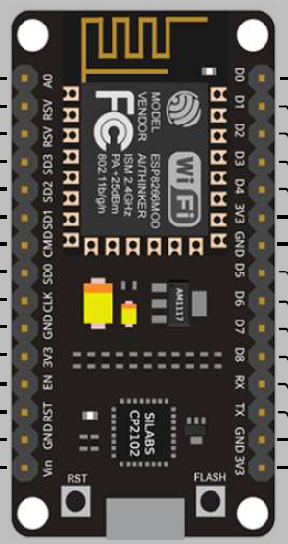
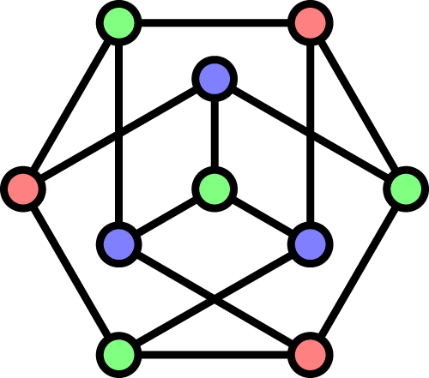
Cyber Sec
Things
Network
Compute
Integrated Testing for IoT Ecosystem

Slide 16

Things
Devices | Sensors | Machines
MII Cybersec

Slide 17
DEFINE: The Things
a.k.a Embedded Systems
Programmable machine built for specific purpose(s)
Sense physical events in surrounding.
Control the connected peripherals.
Adaptive actions, based on the dynamic of events and commands.
Able to communicate with peers and servers, directly or indirectly.
Not all devices are qualified to be “things”

Slide 18
ATTACK: The Things
Physical or Logical
Goal
Change Behavior
Take Over
Disable
Exploitation (memory corruption, race condition, etc.)
Injection (command or telemetry)
Code Rewrite (firmware replace or downgrade)
Side-Channel (timing, hardware glitching, power analysis)
Hardcoded secret
Techniques

Slide 19
Firmware
Most common Analysis Target
Bare Metal Firmware
Full-Stack Firmware
Single program
No operating system
Direct access and full control of low level hardware
Primitive operations.
Typically used for specific hardware.
One or more application
Include embedded OS (ex: linux)
Higher level of operations
Typically used

Slide 20

Network
Data | Protocol | Media
MII Cybersec

Slide 21
DEFINE: The Network
Medium for connection.
Over the air
Over the wire
Uniquely addressing the things by identity.
Protocol for data transport.

Slide 22
ATTACK: The Network
Goal
Disrupt communication
Replay Attack
Spoofing
Packet Tampering
Jamming or Flooding
Techniques

Slide 23
Communication
Data Transmissions
Wireless
Wired
WiFi (IEEE 802.11)
Bluetooth
ZigBee
LoRaWAN
Cellular (GSM, LTE)
Z-Wave
Sigfox
Ethernet (IEEE 802.3)
USB
RS-232
UART

Slide 24
Messaging
Data Transport and Format
MQTT (Message Queue Telemetry Transport)
CoAP (Constrained Application Protocol)
DDS (Data Distribution Service)
AMQP (Advanced Queuing Protocol)

Slide 25

Compute
Storage | Analysis | Visualization
MII Cybersec

Slide 26
DEFINE: The Compute
Aggregate and store all data generated by things.
Process and analyze the data.
Visualize the data, based on certain rules.
Control the things
Web Applications | Web Service | Mobile Application

Slide 27
ATTACK: The Compute
Techniques
Goal
Take Over
Data Exfiltration
Data Modification
Injections
Command
Query
Telemetry
Broken Session
Data Poisoning

Slide 28
References
https://scriptingxss.gitbook.io/firmware-security-testing-methodology/
https://github.com/ReversingID/Awesome-Reversing/
https://wiki.owasp.org/index.php/OWASP_Internet_of_Things_Project#tab=IoT_Top_10

Slide 29

Thank You
xathrya
@xathrya
xathrya
xathrya [at] reversing.id
https://xathrya.id

